Slide 1
Bastion secure processor architecture
Ruby B. Lee
Princeton University

Slide 2
Bastion’s Goals
Protect security-critical software modules within an untrusted software stack
O.S. as a potential adversary
Physical attacks in addition to software attacks
Set up secure compartments for trusted code, rather than sandbox for untrusted code
Secure setup, execution and termination
Resilient execution of security-critical tasks even in the presence of malware and (unrelated) corrupted code in software stack
Enable scalability to multiple mutually suspicious trust domains
Provide a mechanism for reporting trust evidence

Slide 3
Bastion: secure processor-hypervisor architecture
D. Champagne, R.B. Lee, "Scalable Architectural Support for Trusted Software",
IEEE Intl. Symp. on High-Performance Computer Architecture (HPCA), Jan. 2010
Notes:
Secure compartments for trusted code and data rather than sandboxes for untrusted code
End with threat model: CPU chip is trusted
successful internal probe is hard
All other hardware is untrusted
memory chips, external buses, hard drives, etc.
Hypervisor and small Trusted Software Modules are trusted
All other software (OS and applications) is untrusted

Slide 4
Bastion’s Trusted Software Modules
Each TSM has a security segment, module_ID & identity
Securely launched by new SECURE_LAUNCH hypercall
Assigns module_id
Computes module identity
Hash of code & static data, and Hash of security segment
Sets up module memory protection
Security segment

Slide 5
Bastion Virtual Memory Mappings (SW attacks)
Set up by hypervisor during SECURE_LAUNCH hypercall
Hypervisor provides data to CPU on TLB miss
module_id zero reserved for untrusted software

Slide 6
Secure Physical Memory (HW attacks)
hash_tree_root register

Slide 7
Scalable Secure Storage (SS) sealed to each Trusted Software Module or Hypervisor
Notes:
Talk about how you only need one set of (Hash, Key) registers to protect the hyperviser, but then thru the hyperviser’s SSA you can protect arbitrary number of SSAs for arbitrary number of TSMs.

Slide 8
Minimal Layer-skipping Trust Chains
Provide firm anchor (in hardware) for Trust Chains
Prevents “attacks from below”
Enable Minimal trust chains for integrity
Today: Full trust chain Tomorrow: Minimal trust chain
Enable trusted application execution -- even with a compromised OS and/or malware in an untrusted SW stack
Enabling technology: SP or Bastion architecture
Notes:
How to level the playing field for Cyber Security?
Allow security-critical execution even in the presence of malware

Slide 9
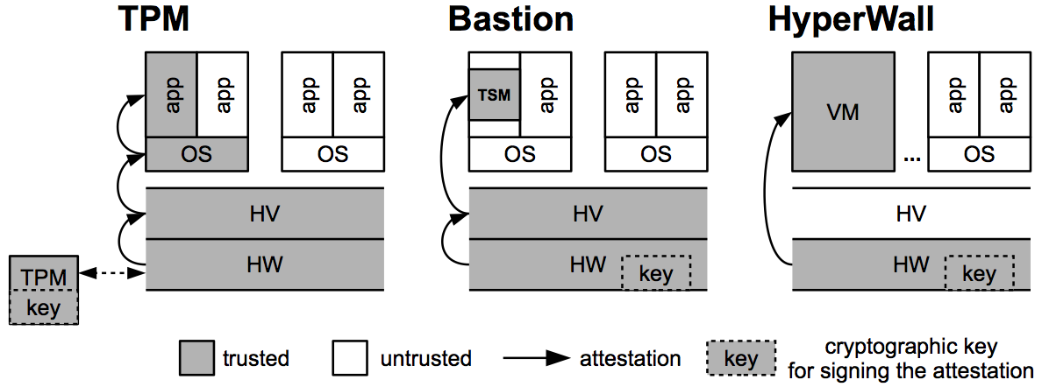
Layer-skipping Integrity Checking
Notes:
hardware can
measure every layer of software, then that software measures other parts of system, or
directly measure only trusted software in question

Slide 10
Attestation of Remote System
Customers need attestation that
correct code is executing on good platform
untrusted subjects have not attempted to compromise the platform, code or data
customer has secure means to connect to the remote code and data

Slide 11
Bastion’s Tailored Attestation

Slide 12
Bastion Architectural Concepts
Bastion architecture is a co-designed Processor-Hypervisor Trusted Computing Base (TCB)
Minimal, layer-skipping trust chain with HW trust anchors
Processor hardware protects Hypervisor
Hypervisor protects Trusted Software Modules
Runtime Protection
Shadow access control for enhanced virtual-to-physical memory mappings (protection from SW attacks)
physical memory authentication (protection from HW attacks)
Secure inter-module control flow
Secure storage sealed to trusted module
Scalability with hypervisor-protected “soft” registers for module-specific trust anchors
Only 2 hardware trust anchors required
Efficient Processor-based Tailored Attestation
Measurement of SW identities at Secure Launch
Runtime protection and Reporting of Trust Evidence with Attest instruction

Slide 13
New Security Mechanisms
Protecting the different phases of security-critical software

Slide 14
Bastion: security mechanisms
Hypervisor Protection
Secure Launch of Hypervisor
Protecting Hypervisor at Runtime
Trusted Software Module Protection
Secure Launch
Secure Virtual-to-Physical Memory Mapping
Secure Physical Memory
Secure Inter-Module Control Flow
Trusted Computing Primitives
Tailored Attestation
Secure Storage
sealed to each Trusted Software Module

Slide 15
Instructions needed
Because of trusted software layer above the hardware, the hypervisor, Bastion only needs 2 new instructions:
Hyperviser secure launch
Attest hypervisor
Rest can be done with software Hypercalls.

Slide 16
Bastion Supports Flexible Trust Domains

Slide 17
Summary: Bastion Security
Hardware-protected hypervisor
Fine-grained module isolation and sharing
Can provide Secure Execution Environments for Trusted Software Modules in App and OS spaces
Authenticated module transitions
Resilient attestation
Secure Memory
Module-specific secure storage

Slide 18
Extras

Slide 19
Beyond SP and TPM
How to scale SP to support multiple simultaneous Trusted Software Modules (TSM) from different trust-domains?
What best security functions provided by TPM can be built into microprocessor? How?
Enable resilient execution of security-critical tasks
Provide resilient attestation

Slide 20
Extending SP: Design Goals
Provide application-level security without trust in OS (SP philosophy)
Extend the SP architecture to support multiple TSMs (main thrust)
Support full-blown memory integrity
Offer each TSM a piece of secure storage
Multiple TSM support means we need to:
identify TSMs at launch
distinguish between TSMs at runtime
manage multiple contexts
provide remote attestation

Slide 21
The Hypervisor as a “Super TSM”
Managing multiple secure contexts in hardware is hard
Hardware has poor visibility into software contexts
Very limited on-chip storage
Complex, “software-type” management functionalities required
A thin hypervisor is great as a secure context manager:
Fits in a few thousand lines of code
Decent visibility into software context
Quasi-unlimited secure storage
Can easily handle whole range of critical tasks
TSM launch
runtime identification
secure context switch
etc…

Slide 22
Secure Module Transitions
Asynchronous transitions:
Triggered by: module preemption/resumption
Hypervisor action: save/restore module registers
Synchronous transitions:
Triggered by: call_module/return_module instructions
Hypervisor action: check call/return sequence, authenticate caller/callee

Slide 23
Conclusions
Bastion TCB provides Tailored Attestation: resilient, functional attestation
This is enabled by TCB mechanisms providing core security functions:
Hardware-protected hypervisor
Fine-grain module isolation and sharing
Authenticated module transitions
Module-specific secure storage
An implementation on OpenSPARC demonstrates feasibility and improved performance over TPM attestation and secure storage

